Slide 1
CSC 3210 Computer Organization and Programming
Lab Work 10
Dr. Zulkar Nine
mnine@gsu.edu
Georgia State University
Spring 2021

Slide 2
Learning Objective
Logical instructions and loops

Slide 3
Disclaimer
The process shown in these slides might not work in every single computer due to Operating system version, Microsoft Visual Studio versions and everything.
If you find any unusual error, you can inform the instructor.
Instructor will help you resolve the issue.

Slide 4
Attendance!

Slide 5
Lab Work 10 Instructions
Lab 10 : Conditional statements and loop
Due Date: 04/02/21 11:59 PM

Slide 6
Plan early …
You have one week time to submit the lab
Start early
If you have issues
Email TA or instructor
Stop by during office hours
Start working at the last moment is not a good idea.
AppendixA shows how to check memory data and Appendix B shows how to create a new project.

Slide 7
Problems in this lab
You might see similar questions in the quizzes and exam.
During the exam you might need solve similar problems without visual studio.

Slide 8
A review
CMP and conditional jumps

Slide 9
CMP Instruction
The most common boolean expressions involve some type of comparison:
if A > B ...
while X > 0 and X < 200 ...
if check_for_error( N ) = true
CMP instruction is used to compare integers (signed and unsigned)
Compares the destination operand to the source operand (HOW 🤔)
CMP performs implied subtraction of source operand from destination operand
Nondestructive subtraction of source from destination (destination operand is not changed)
Syntax:
🗝
CMP destination, source
Notes:
Wed, Oct-11,3pm

Slide 10
Jcond Instruction
A conditional jump instruction branches to a label
When specific status flag condition is true
Syntax
Jcond destination
cond refers to a flag condition identifying the state of one or more flags.
The following examples are based on the Carry and Zero flags:
CPU status flags are most commonly set by
arithmetic, comparison, and boolean instructions.

Slide 11
Conditional Jumps (Example1)
First, an operation such as CMP, AND, or SUB modifies the CPU status flags.
Second, a conditional jump instruction tests the flags and causes a branch to a new address.
🗝
Compare and then Jump or NOT
- The CMP instruction compares EAX to Zero.
The JZ (Jump if zero) instruction jumps to label L1 if the Zero flag was set by the CMP instruction:
cmp eax,0
jz L1 ; jump if ZF = 1
.
.
L1:
.
.

Slide 12
Conditional Jumps (Example2)
First, an operation such as CMP, AND, or SUB modifies the CPU status flags.
Second, a conditional jump instruction tests the flags and causes a branch to a new address.
🗝
Compare and then Jump
The AND instruction performs a bitwise AND on the DL register, affecting the Zero flag.
The JNZ (jump if not Zero) instruction jumps if the Zero flag is clear:
and dl,10110000b
jnz L2 ; jump if ZF = 0
.
.
L2:

Slide 13
Types of Conditional Jumps Instructions
Conditional jump instructions are able to
Compare signed and unsigned integers and
Perform actions based on the values of individual CPU flags.
The conditional jump instructions can be divided into four groups:
Jumps based on specific flag values
Jumps based on equality between operands or the value of (E)CX
Jumps based on comparisons of unsigned operands
Jumps based on comparisons of signed operands

Slide 14
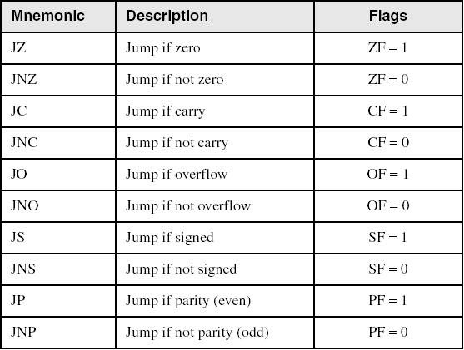
Jumps Based on Specific Flags

Slide 15
Jumps Based on Equality

Slide 16
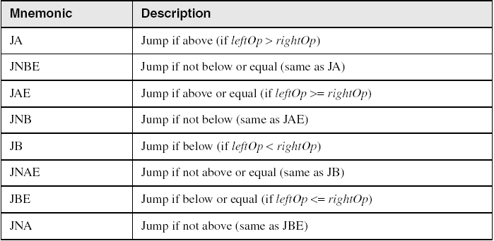
Jumps Based on Unsigned Comparisons
A and B

Slide 17
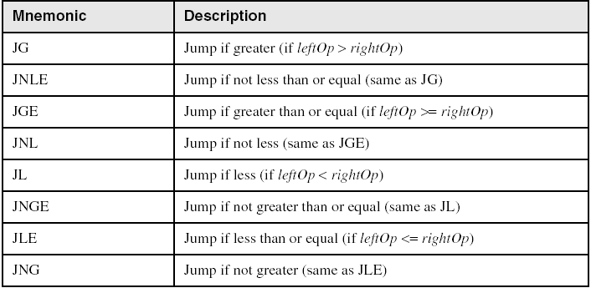
Jumps Based on Signed Comparisons
G and L

Slide 18
IF Statements: Example1 (IF-Then)
IF statement is translated into assembly language with a
CMP instruction followed by
Conditional jumps.
If op1 or op2 is a memory operand (a variable):
one of them must be moved to a register before executing CMP.
Implement the following pseudocode in assembly language.
All values are unsigned:
if( ebx == ecx )
{
eax = 5;
edx = 6;
}
cmp ebx,ecx
je L1
jmp L2
L1:
mov eax,5
mov edx,6
L2:
A and B
(There are multiple correct solutions to this problem.)

Slide 19
IF Statements: Example1 (IF-Then)
IF statement is translated into assembly language with a
CMP instruction followed by
Conditional jumps.
If op1 or op2 is a memory operand (a variable):
one of them must be moved to a register before executing CMP.
Implement the following pseudocode in assembly language.
All values are unsigned:
if( ebx == ecx )
{
eax = 5;
edx = 6;
}
cmp ebx,ecx
jne next
mov eax,5
mov edx,6
next:
A and B
Reverse The IF Condition
(There are multiple correct solutions to this problem.)

Slide 20
Example: Check Larger of two integers
Assume two signed integers stored in EAX and EBX register. Write a code that transfers largest integer into variable called MAXIMUM.
.data
maximum DWORD ?
.code
; Store first item to EAX register
MOV eax, 21
; Store the second item into EBX register
MOV ebx, 19
CMP eax, ebx
JG L1
JLE L2
L1: MOV MAXIMUM, eax
JMP Next
L2: MOV MAXIMUM, ebx
Next:
Don’t need to turn in!

Slide 21
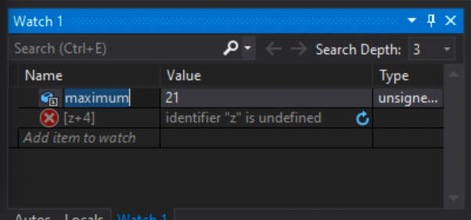
Debug the code
Enter the debug mode
and open watch window. Go to Debug-> Windows -> Watch -> Watch1
Enter the variable name maximum in watch window
Then debug the code
until you reach “INVOKE ExitProcess”

Slide 22
Example: Find the smallest among three items
Let’s assume, the values are V1, V2, and V3 and you want to store the smallest item into AX register.
Logic:
If V1 <= V2
Mov minimum, V1
Else
Mov minimum, V2
If V3 < minimum:
Mov minimum, V3

Slide 23
Find the smallest among three items
Logic:
If V1 < V2
Mov minimum, V1
Else
Mov minimum, V2
If V3 < AX:
Mov minimum, V3
.data
V1 SWORD 10
V2 SWORD 13
V3 SWORD -5
minimum SWORD ?
.code
﻿mov ax, V1
mov bx, V2
mov cx, V3
cmp ax, bx
jle IF_Block ;if V1 < V2, jump to IF block
jg ELSE_Block
IF_Block:
mov minimum, ax
jmp next
ELSE_Block:
mov minimum, bx
next:
cmp cx, minimum ; ;if V3 < minimum, jump to IF_block2
jle IF_Block2
jmp L1
IF_Block2:
mov minimum, cx
L1:
Don’t need to turn in!

Slide 24
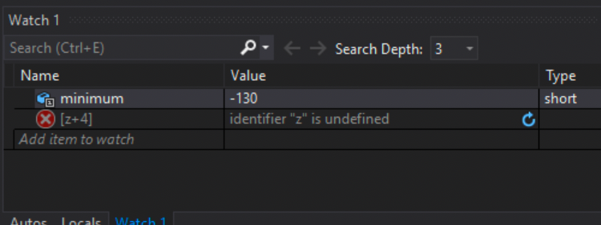
Debug the code
Enter the debug mode
and open watch window. Go to Debug-> Windows -> Watch -> Watch1
Enter the variable name minimum in the watch window
Then debug the code
until you reach “INVOKE ExitProcess”

Slide 25
Lab 10
Submission

Slide 26
Submission Instruction
Write an assembly program to find the largest item in an array and store it in a variable named MAXIMUM.
Hint: Use both Jump and loop instructions to write the program.
logic:
Assume that the first item of the array is the minimum and store it in variable MAXIMUM
Write a loop. Inside the loop, compare the each array item with the minimum
If the array item is less than the MAXIMUM, update MAXIMUM with that array item.
.data
Array WORD 10, 2, 23, 45, 21, 11
MAXIMUM WORD ?
.code
; write your code

Slide 27
Submission Instruction
Submit the screenshot of your code.
Debug your code until you reach INVOKE ExitProcess, 0
Take a screenshot of the watch window showing variable MAXIMUM.
Submit the screenshot.
Also, Rename the asm file using your last name as Lastname.asm
Submit the ASM file as well.

Slide 28
Appendix A
Checking Memory Data

Slide 29
Checking Memory Data
Use Memory window to verify the values of memory locations.
To activate Memory window, run the debugger, go to debug menu and click on windows, open it, go to Memory then choose Memory1.
When you run your program and step over every line you will see the changed values marked with red color.
You Must be in the Debugging Mode to see the memory or the register window

Slide 30
Checking Memory Data
To activate Memory window,
if you want to see the location of your variable in the memory,
Memory window search box (on the top of the memory window, Address:)
write & follow it with the variable name: example: &myVall.
This will take you to the memory locations of your program (.data section).

Slide 31
Checking Memory Data
To activate Memory window,
You can right-click inside the memory window
You will see Popup menu for the debugger’s memory window
You can choose how you want to group your bytes: by 1,2,4, or by 8
You can also presents data in hexadecimal, signed, or unsigned display

Slide 32
Appendix B
Create a Project

Slide 33
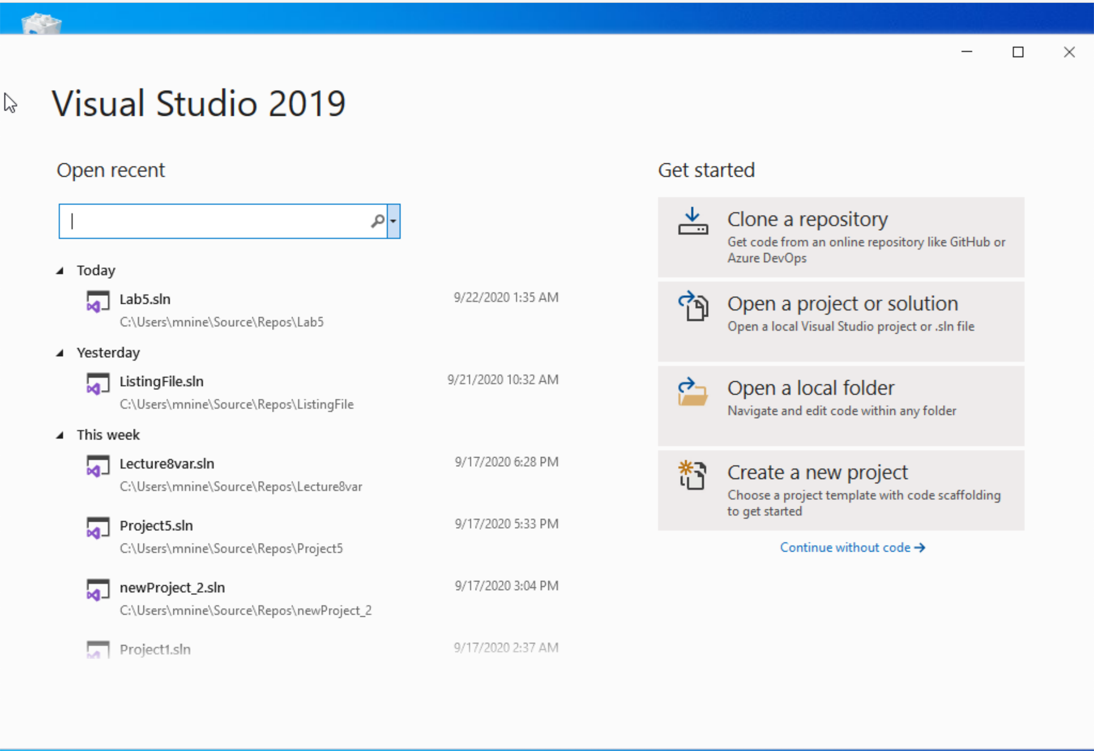


Step 1: Create a project (1)
Start Visual Studio
Click Create a new Project

Slide 34
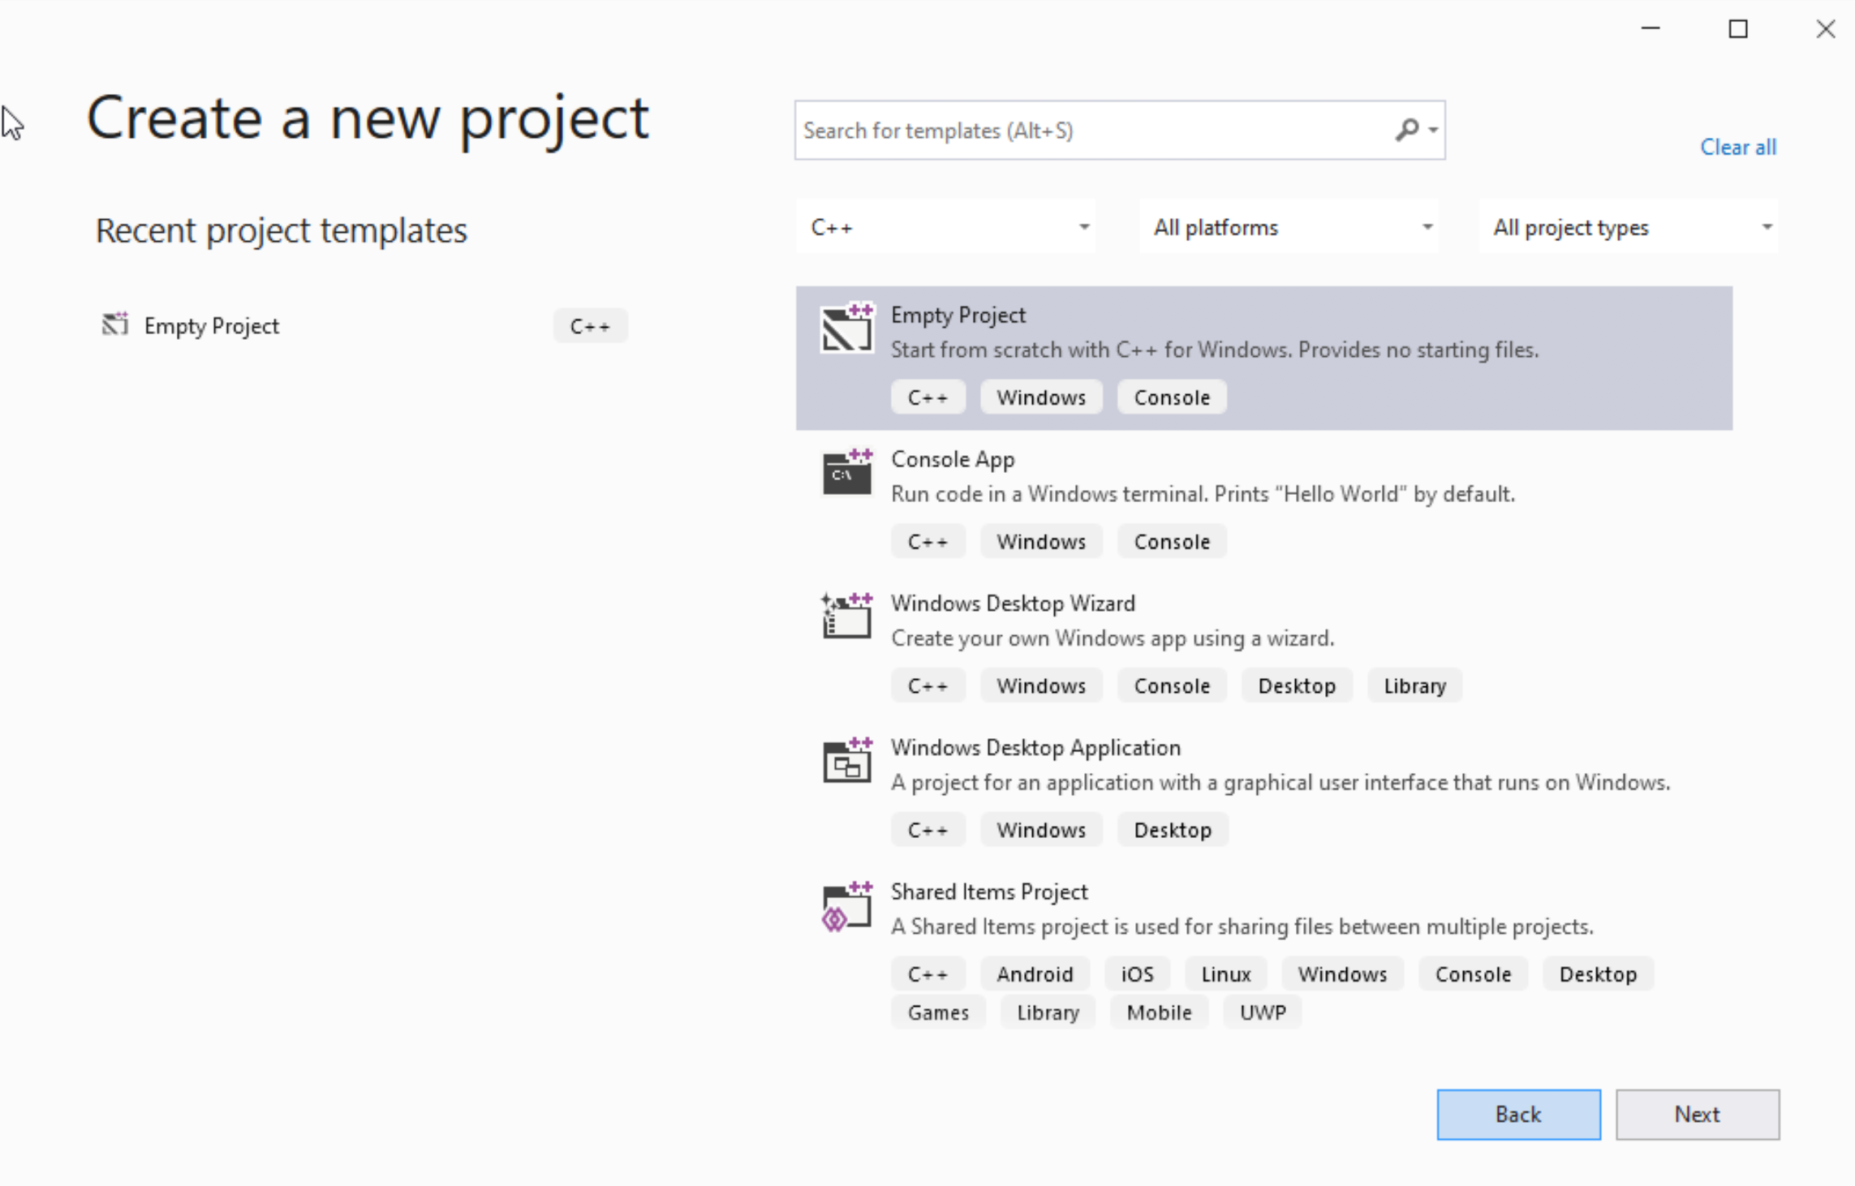




Step 1: Create a project (2)
Select C++ as language
Select Empty Project
Click Next

Slide 35
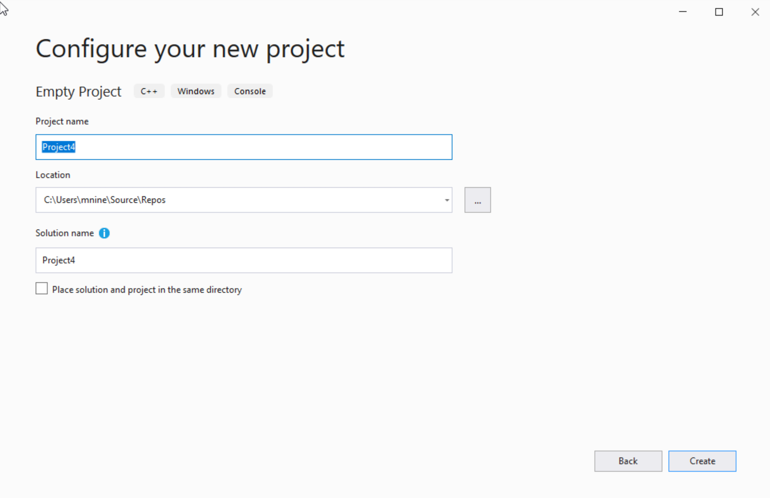

Step 1: Create a project (3)
You can change the project
name as you like
Also, you can change the
project location
Click Next

Slide 36
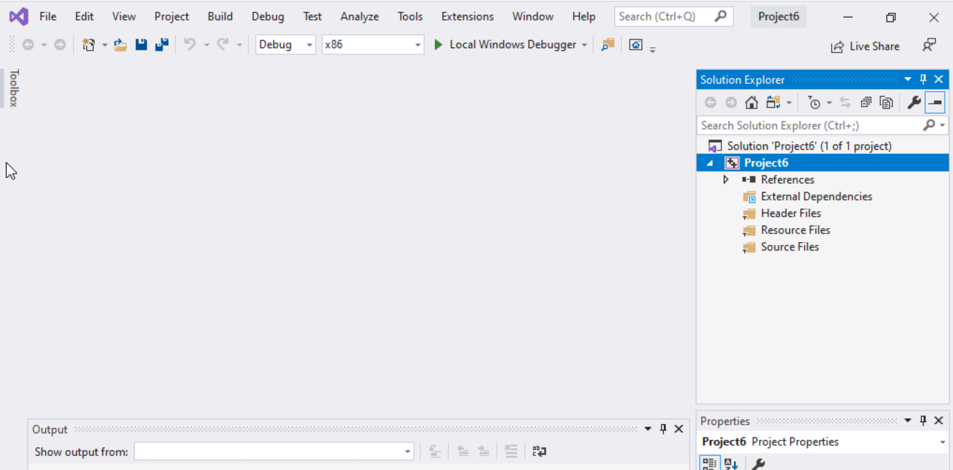
Step 1: Create a project (4)
Delete the
Following folders:
Header files
Resources Files, and
Source Files

Slide 37
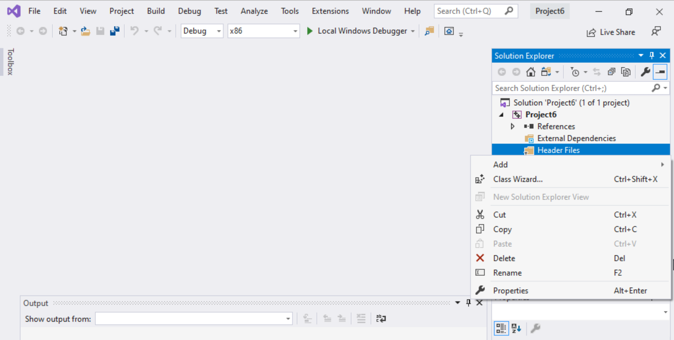
Step 1: Create a project (5)
To delete :
Select the folders
Right click on it
Select delete

Slide 38
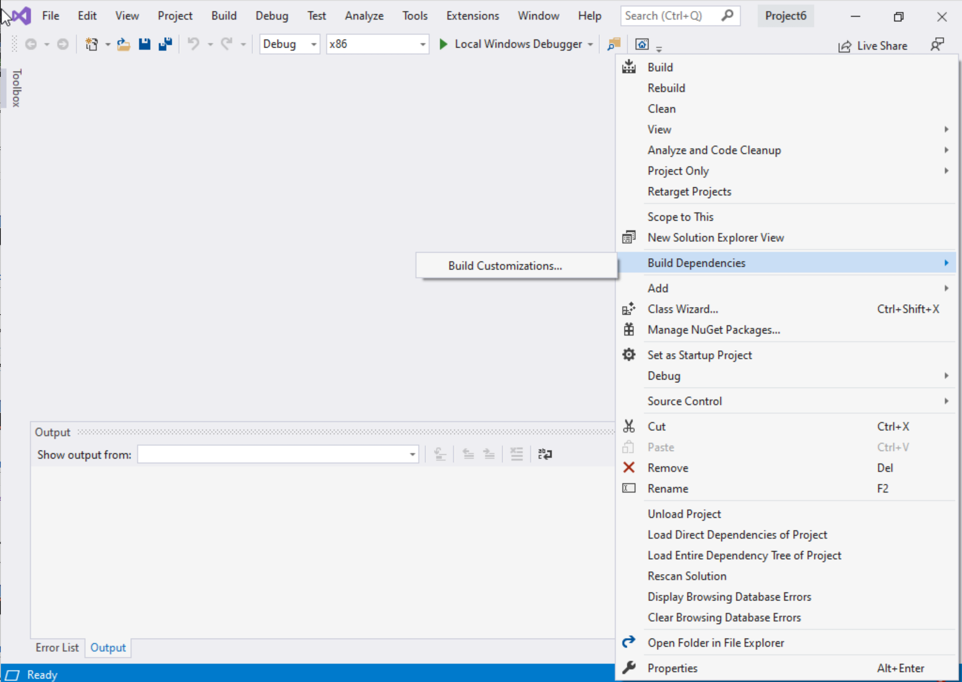
Step 1: Create a project (6)
Select Project Name on solution explorer
Right click on it
Go to Build Dependencies
Click on Build Customizations

Slide 39
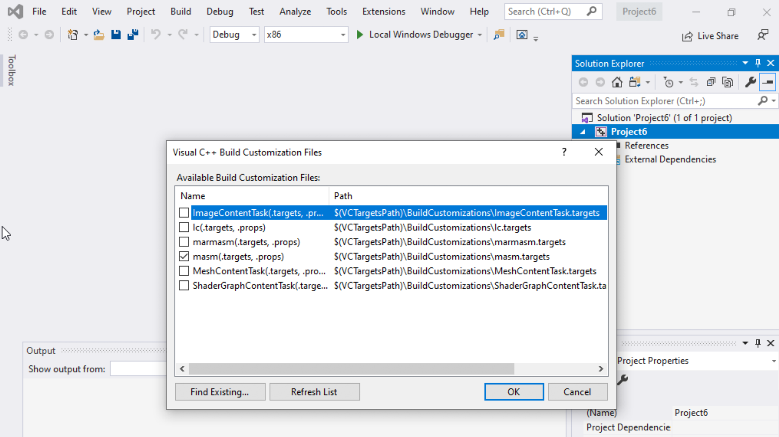
Step 1: Create a project (7)
Select masm(.target, .props)
Click ok

Slide 40
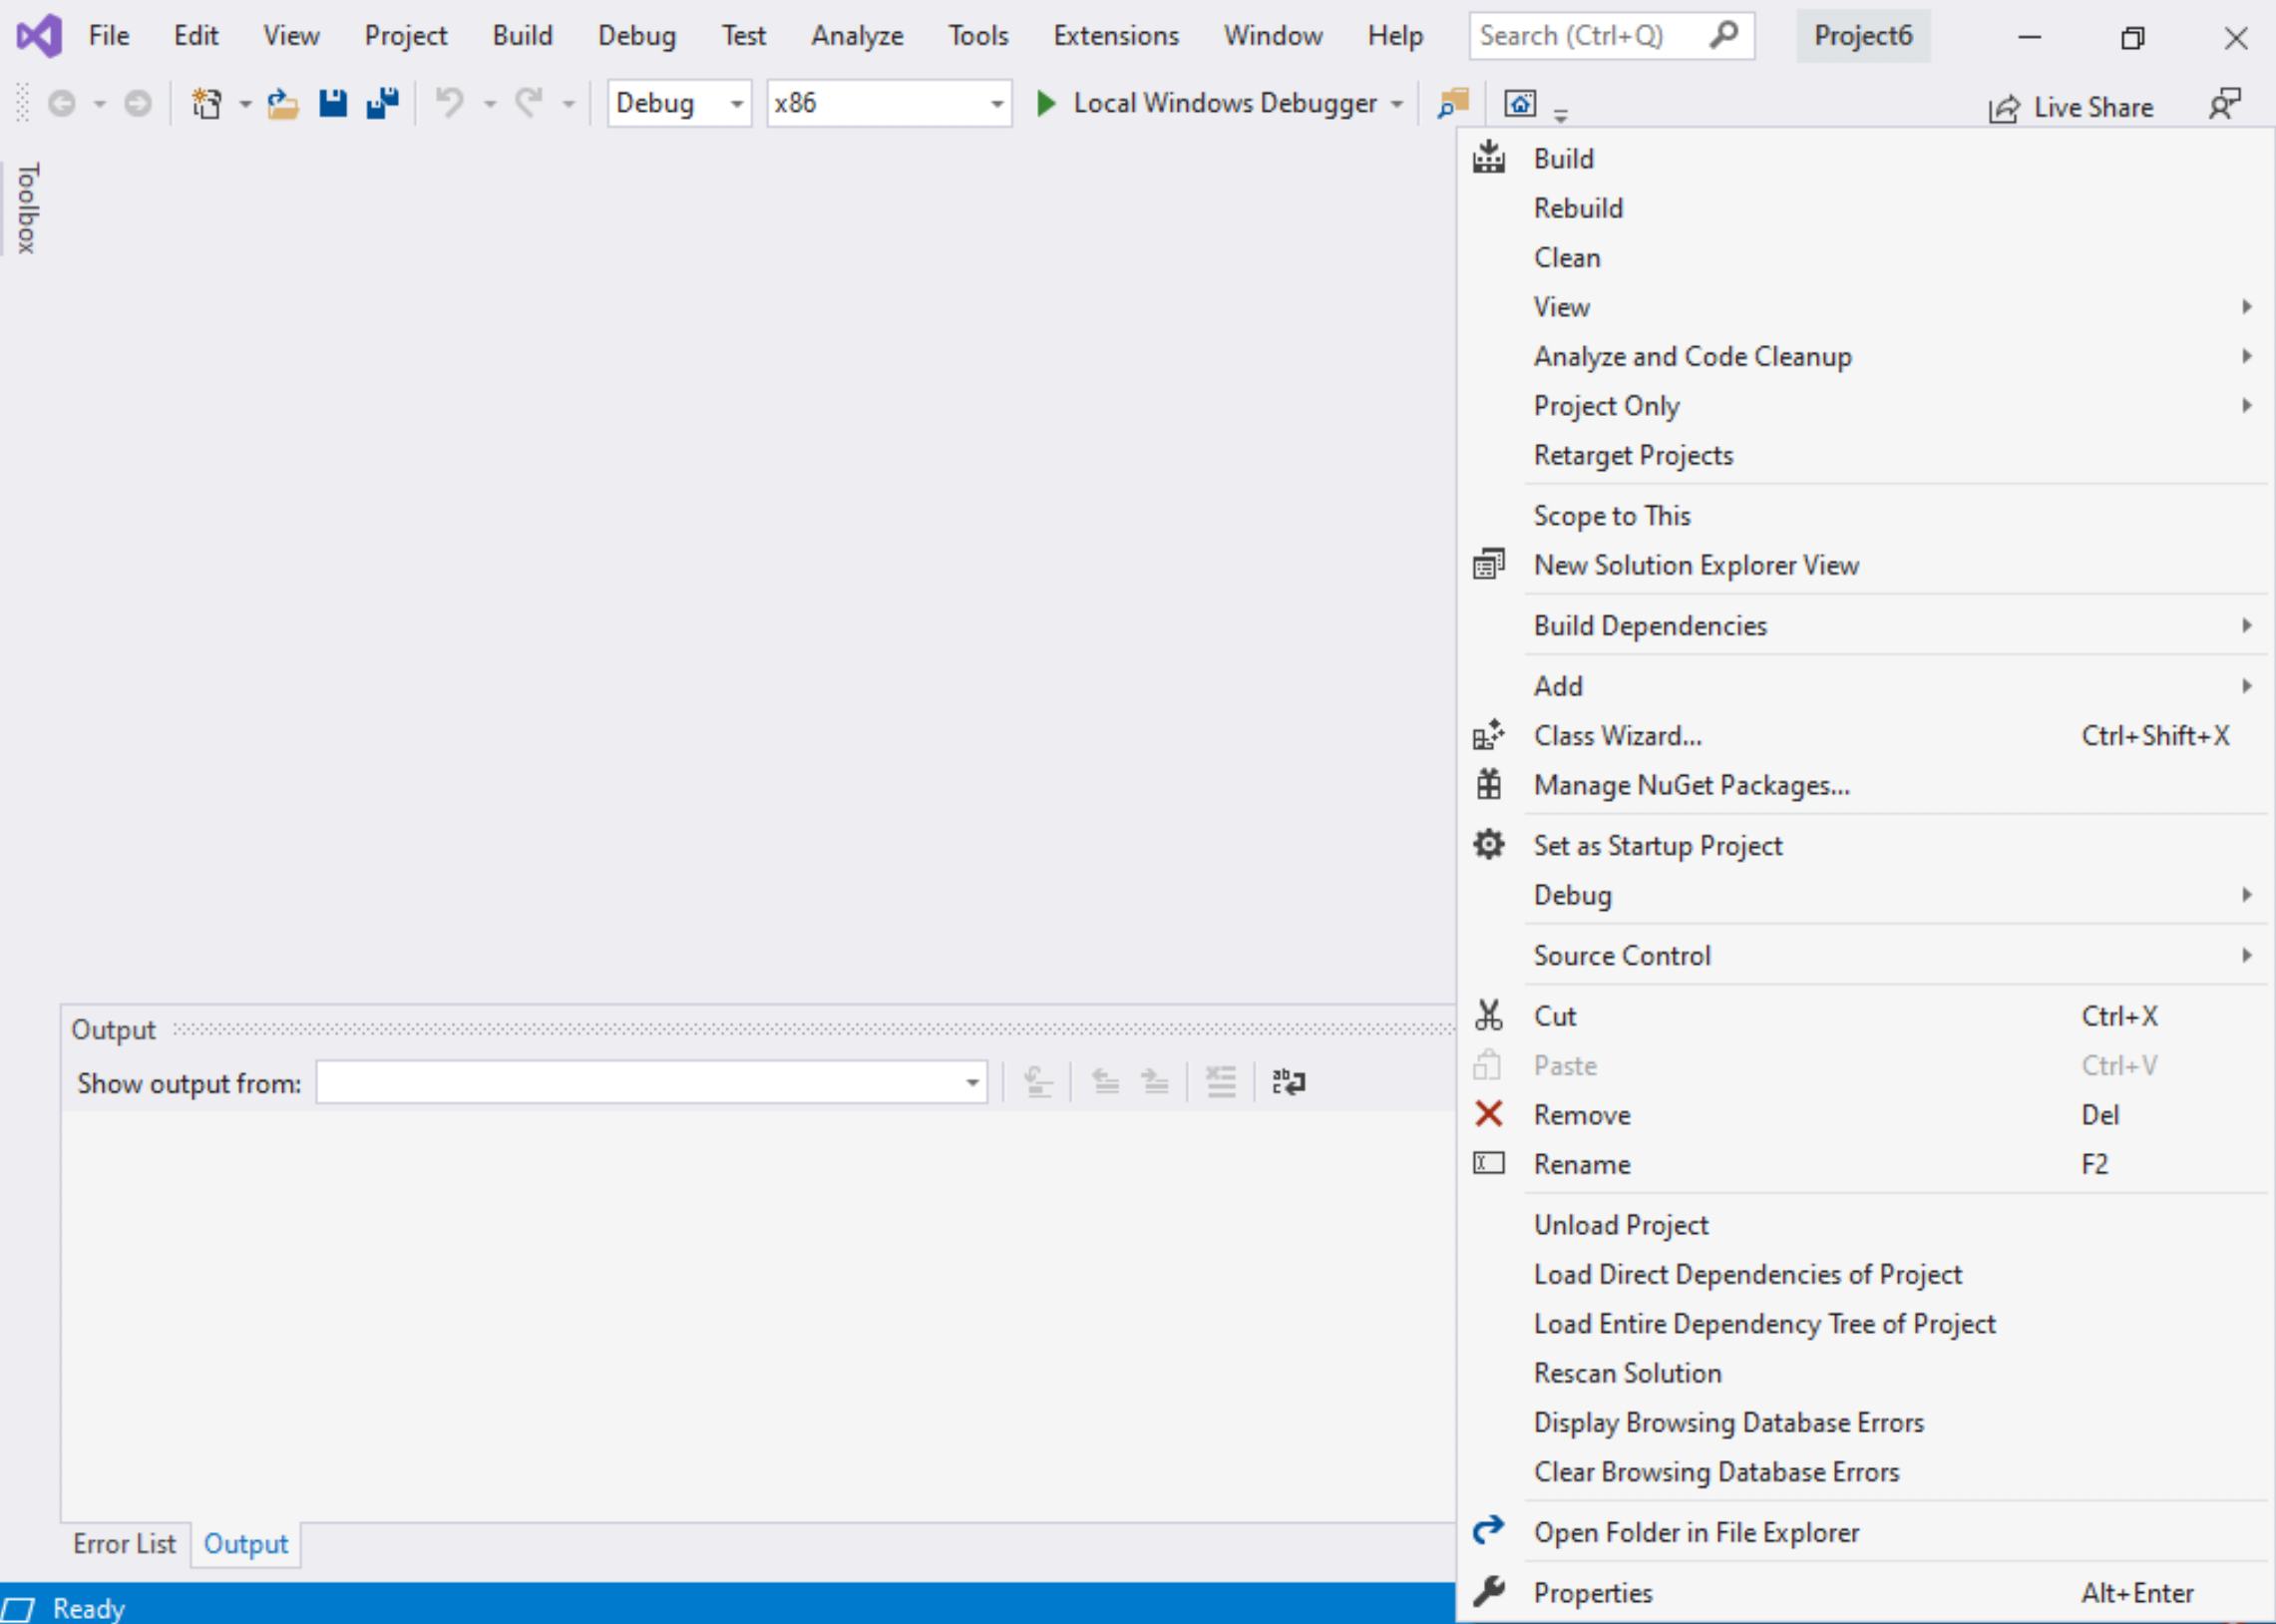
Step 1: Create a project (8)
Right click on the Project name in the solution explorer
Click properties

Slide 41
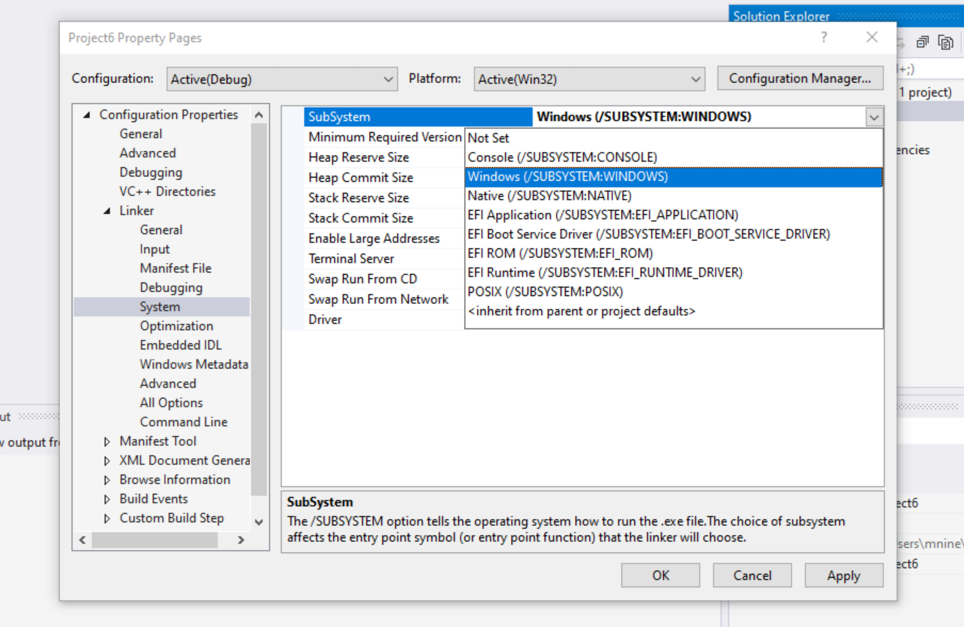

Step 1: Create a project (9)
Expand the ‘Linker’
Select ’System’
Select Windows(/SUBSYSTEM:WINDOWS)
Click OK

Slide 42
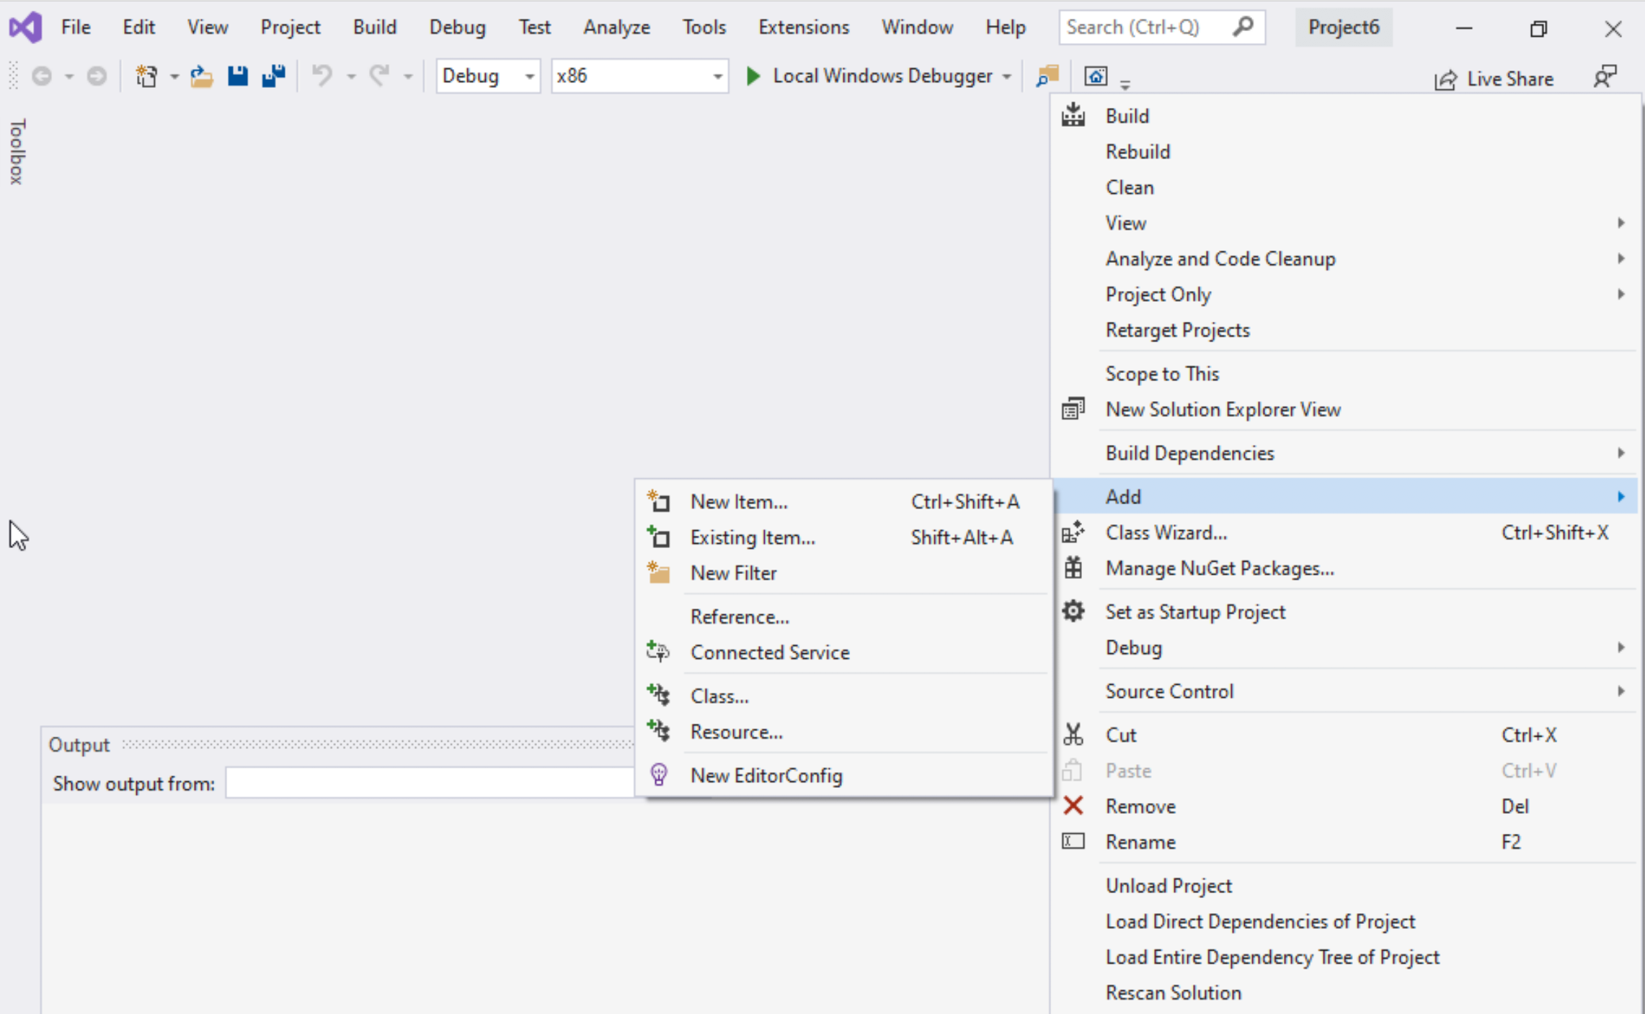
Step 1: Create a project (10)
Select Project name on solution explorer
Right click on it
Expand Add
Choose New Item

Slide 43
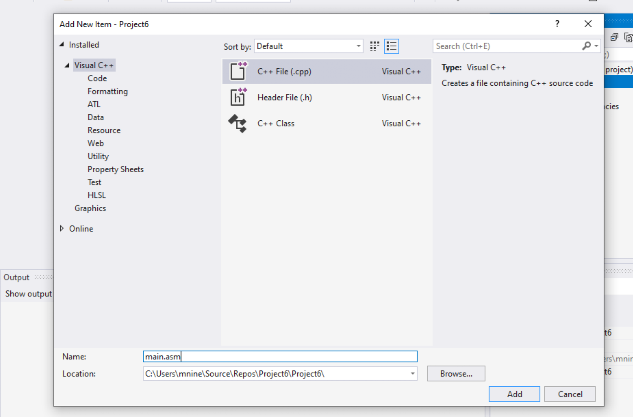


Step 1: Create a project (11)
Select C++ File(.cpp)
Name: main.asm
Click Add

Slide 44
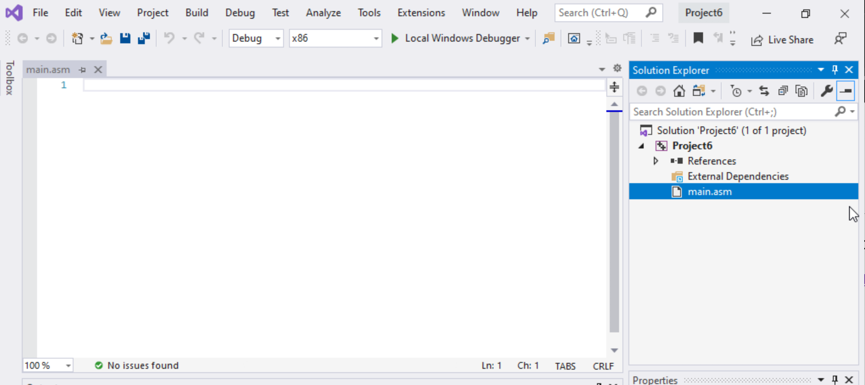

Step 1: Create a project (12)
Select main.asm
Add your code
In the main.asm File.

